Slide 1

MYSQL – SQL Fundamentals

Slide 2
MYSQL -- RDBMS
What is Data? – collection of alphabets / numbers. (Employee, projects, websites),
Booking, cancellation, customer, stations, train, trips ,meal plans, employees, shift (entities)
Any information in any form (table, file)
Airline business (indigo – customer, planes, seat in planes, reservation / booking, cancellation, partners, employees, routes, cities /locations, trip)
Collection of information. (TCS – provides services to their business customers.) – employee, department, location, technology, customers, suppliers
where do we store data?
RDBMS (Structured)
NOSQL (semi structured)
HDFS (big data)
Files (csv, txt, JSON…)
What is the database?
Software which helps to organize and manage data.
Different types of databases
What is RDBMS?
Codd’s Rules
(SQL, NULL value support, key attributes should be used to get one single row (row identifier), Table, Views, Online catalog)
What do you mean by entity, attribute and domain?
Entity example --? Product (product_id, name is an attribute)
Domain example → Data types (integer, varchar(20))
Relationships between entities.
One : One
One : Many
Many: Many

Slide 3
Information Visualization
Business
TABLES
TABLES
Line of Business
TABLES
TABLES
TABLES
Business Process
TABLES
TABLES
SQL
Activity
Information
APPLICATIONS
(Python /JAVA /.NET / Mobile etc)
DATA

Slide 4
MYSQL High Level View
MYSQL server consists of multiple components.
In the picture you can see
Connection layer which establishes and manage the sessions between MYSQL and Applications
SQL Layer which takes care SQL Engine (Listen, Process and give back the results / error)
Storage layer which stores the data.
Applications we build can be
Web Application
Mobile Application
Application Programming Interface (API)
iOT Application
Client Application
(mysql workbench)
Java, Node, PHP…. Application
Batch Programming Scripts which extracts data or load data
MYSQL Server
Connection Layer
SQL Processing Layer
Storage Layer

Slide 5
MYSQL Server
On Premise
You can install the MYSQL Server with in your office infrastructure
Server Name
Database Management
User Management
All the above H/W, S/W and configurations are done by DBA team.
On Cloud
Cloud providers provider MYSQL Database as a service.
These cloud databases are managed by the service provider
In AWS, we get the mysql as part of AWS RDS Service.
We use the following end point to connect one of our MYSQL database in AWS
ibridge.ckyleyx0qknc.ap-south-1.rds.amazonaws.com

Slide 6
Connecting to MYSQL Server
Install MYSQL client on your laptop.
Install MYSQL workbench on your machine to connect to any server to which you have access.
If you installed the local mysql server, then you can connect to localhost to get access to your database.
You will get the server, user, password and to the database which you should connect from your team.
Establish the connection to the MYSQL Server, if you face the issue, reach out to the system administrator.

Slide 7
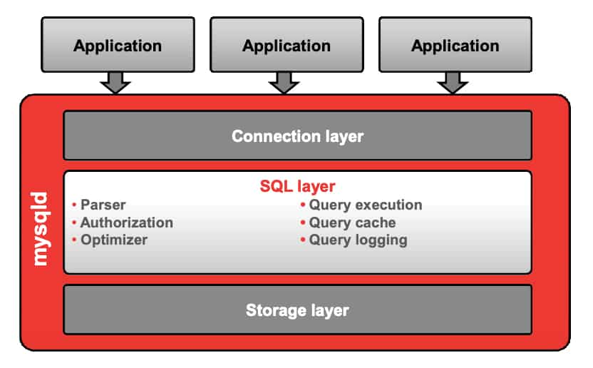
SQL Layer
When we send an SQL from front end, after authentication, SQL engine does multiple activities.
Parser – Parses the query to make sure the database have the objects we refer to
Authorization – security layer which make sure’s we have right access to the applicable operation Optimizer – analyzes the objects which we access and makes the system to choose the right indexes and execution plat to get the data faster. Query Logging – As per the ACID property, we need to make sure all the logs are in place to take care of any issues we face because of failures in networks and systems.
Query cache – on certain repeated queries, storing the data in the processing area improves the performance.

Slide 8
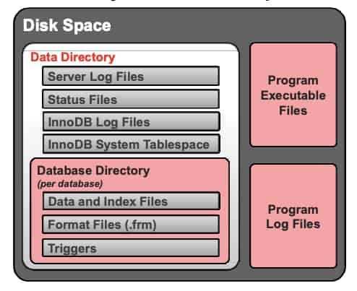
Disk Space in MYSQL
As a developer its important for you to understand what goes behind the scenes in the MYSQL storage.
All the data we push gets stored in different files.
All the database files will be used to store the tables, indexes and records which we push to the database.
Program log files make sure every activity is tracked as a proof of transaction (if questioned) or for recovery when some hardware or system software fails.
Every activity is tracked in every application to make sure when failure happens, there is a traceability to application developers and DBA’s (Database Administrators)

Slide 9
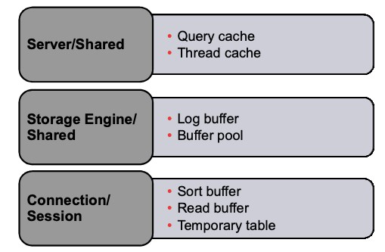
Memory Related Resources
While processing data sets to get the related data from different tables, RDBMS engine uses temp space in terms of RAM and files to accomplish the task.
Understand what cache means in computing perspective to get clarity.
an auxiliary memory from which high-speed retrieval is possible.
store (data) in a cache. the operating system tries to cache every disk operation
Server allocates memory to serve individual users and shares certain operations.
Connection / session is at every connection level. If we have 50 users accessing the data at the same time internally it manages so many sessions to maintain the isolation (remember acid property – isolation is one of principles)

Slide 10
SQL Language
DDL – Define the object (employee, department, customer, product, tickets)
Create – Creating the new table in the database
Alter – Changing the existing table (Add a column, drop a column, change data type etc)
Drop – Dropping the table. The structure of the database gets changed. It deletes all the rows as well when we drop the table.
DML – Manage the data in the tables (add, modify, remove or view)
Insert – used when you are adding new record into the table
Update – used to change the data what we already have in the table
Delete – removing the record in a table. The number of records gets reduced after this statement.
Select – View the data what we have in the table. Reading the data from the tables is the main job.
DCL – Control the access (security)
Grant – Giving permission (select, insert, update, delete, create, alter etc) to a user.
Revoke – Take the permission back from the user on one or multiple objects.

Slide 11
Fundamentals to deal with data
Tables
Columns
Data types
Constraints
PK (Primary key) & FK (Foreign key)
NOT NULL
CHECK, DEFAULTS
SQL Functions
As we have functions in any language, we have functions in SQL
String Functions to deal with char / varchar / string data types. We want to display only the first three characters from your name (example)
Date Functions to deal with date data types. If we store Date of birth (dob) of customer or employee, then we may want to show the age. In this case we use date functions to calculate / derive the age. Think about for a minute how you calculate the age based on your date of birth. This will give you a idea of date function usage.
Number functions to deal with number manipulation. Abs is a function which returns the positive number whether you pass the –ve or + ve number. It always gives the number as positive number.
Remembering that every RDMBS provides certain set of functions is the key to become comfortable while writing queries.

Slide 12
DATA Types
Integer
BigInt
Double
Float
char
Varchar
TEXT
Date
Timestamp
BLOB

Slide 13
Tables (Creation Example)
CREATE TABLE PRODUCT_FAMILY (PF_ID INT PRIMARY KEY, PF_CODE varchar(10) NOT NULL, PF_DESC varchar(30) NOT NULL)
CREATE TABLE PRODUCT_CATEGORY (PC_ID INT PRIMARY KEY, PC_CODE varchar(10) NOT NULL, PC_DESC varchar(30) NOT NULL, PF_ID INT REFERENCES PRODUCT_FAMILY(PF_ID))
CREATE TABLE PRODUCT ( P_ID INT PRIMARY KEY, P_NAME VARCHAR(20) NOT NULL, PRICE FLOAT DEFAULT 0, COST FLOAT DEFAULT 0, LAUNCHED_DATE DATE, PC_ID INT REFERENCES PRODUCT_CATEGORY(PC_ID))

Slide 14
Auto Increment for a PK
CREATE TABLE bank_txns ( txn_id int NOT NULL AUTO_INCREMENT, txn_date date NOT NULL, txn_type varchar(4), amotxn_type float default 0, PRIMARY KEY (txn_id));
Insert into bank_txns (txn_date,txn_type,amount) values (sysdate(),’DEP’,2000)
The above statement will auto increment the txn_id based on the max txn_id + 1 in the table.

Slide 15
Alter Table (Foreign Key handling)
ALTER TABLE city ADD FOREIGN KEY (state_id) REFERENCES state(state_id);
ALTER TABLE Case ADD CONSTRAINT FK_Docid FOREIGN KEY (doc_id) REFERENCES doctor(doc_id);
ALTER TABLE Case DROP FOREIGN KEY FK_Docid;

Slide 16
Data Manipulation Language (CRUD)
Create a record (INSERT)
INSERT INTO TABLE VALUES (…….._
INSERT INTO TABLE (Col1, Col3, Cole5) values (…….)
Insert into table Select Statement
Read a record (SELECT)
Simple, Sub Query, Join, Aggregate Queries
Correlated Sub Query, Set Operators, Derived Query, Analytical Queries
Update a record (UPDATE)
Change the information which already exists
Update product set p_price = 8500 where p_id = 604
Delete a record (DELETE)
Removes the record from the table.
Delete product where p_id = 604
SET SQL_SAFE_UPDATES = 0 → use this set update when you are deleting or updating with out using PK in the where clause. By default sql safe update options is ON.

Slide 17
Types of Queries
Simple Query – one table one scan operation can be done.
Sub Query – one table two scans operations can bet done. Two tables one scan each
Joins – we want result set which consists of columns from both the tables.
Aggregate Queries – summarization (count, max, min, avg, sum)
Co-related Sub Query – one table two scan operations. Outer query executes, the inner query executes as many number of records we have it the outer query.
Set Operators – using UNION, UNION ALL, INTERSECT and MINUS.
Derived Table – considering a result set as a table in the select statement is called as derived table.
Analytical Queries – Usage of Rank, Dense_Rank, Lag, Lead etc

Slide 18
Simple Query
If you are using one table and one scan to get the result set then we can use simple query.
For example we have 100 product records in the table, we want the products which costs more than 1000 Rs and which gives profit more than 150 Rs and which was launched in the current year.
Even though we have three conditions in the criteria of filter, we scan the table only once. So your query is
Select product_name, cost, price-cost as profit, launch_dt from product where cost > 1000 and price – cost > 150 and year(launch_dt) = year(sysdate())
The above query uses one table and we scan the table from top to bottom once to get the result.

Slide 19
Simple Select

Slide 20
Sub Query
Sub Query is the type of query which solves two step process. Sub query consist of inner query and outer query. Inner query executes first and the outer query executes next. The output of inner query becomes input / condition to the outer query.
Consider we have product entity with product_id, product_name, cost, price, launch_date, prod_category
We want to find the product which costs more than the product ‘xyz’
We want to find the product which are launching after the launch of product ‘xyz’
We want to find the costliest product name in the table
Find all the products which are in the same category as product ‘Monitor’
Find all the products which are priced higher than the avg price of all the products.

Slide 21
MySQL Functions
Functions are simply pieces of code that perform some operations and then return a result.
Some functions accept parameters while other functions do not accept parameters.
Types of functions
Built-in functions
MySQL comes bundled with a number of built in functions. These functions allow us to perform different types of manipulations on the data. The built in functions can be basically categorized into the following most used categories.
Strings functions – operate on string data types
Numeric functions – operate on numeric data types
Date functions – operate on date data types
Aggregate function – operate on all of the above data types and produce summarized result sets.

Slide 22

String Functions
String Functions
String functions are used to manipulate
Text data in MySQL. CONCAT,SUBSTR,UPPER,LOWER,
RIGHT,LEFT,REPLACE,REVERSE,RPAD,LPAD,LENGTH,
TRIM are some of the most commonly used functions.
These functions can help you to format and clean
up your data to ensure consistency and accuracy

Slide 23
String Functions
Name | Description | Example
CONCAT | Concatenate two or more strings into a single string | select concat(city_id,'-',city_name) from city;
INSTR | Return the position of the first occurrence of a substring in a string | select instr(city_name,'o') from city; Select INSTR(‘sutudent1@ibridge360.com','@')—return 10
LENGTH | Get the length of a string in bytes and in characters | select length(city_name) from city;
LEFT | Get a specified number of leftmost characters from a string | select LEFT(city_name,3) from city;--Return 3 character
RIGHT | Get a specified number of rightmost characters from a string | select RIGHT(city_name,3) from city;--Return 3 character from right side
MID | This function in MySQL is used to extract a substring from a given input string | Syntax:MID(text, start position,no_of_characters) select mid(city_name,1,4) from city;
LOWER | Convert a string to lowercase | Select LOWER(city_name) from city;
UPPER | Convert a string to uppercase | Select UPPER(city_name) from city;
LTRIM | Remove all leading spaces from a string | select ltrim(" mysql") from dual;
RTRIM | Remove all trailing spaces from a string | select rtrim("mysql ") from dual;

Slide 24
String Functions
Name | Description | Example
REPLACE | Search and replace a substring in a string | REPLACE(str, find_string, replace_with) select replace('malayalam','a','z') from dual;select replace(customer_name,customer_name,customer_address) from customer;
SUBSTRING | Extract a substring starting from a position with a specific length. | SELECT SUBSTR("MySQL Tutorial", 7,8) AS ExtractString from dual;
SUBSTRING_INDEX | Return a substring from a string before a specified number of occurrences of a delimiter | SELECT SUBSTRING_INDEX("www.mysql.com", ".", 2);---Return ‘www.mysql’
TRIM | Remove unwanted characters from a string. | SELECT TRIM(' My SQLTutorial ') AS TrimmedString; select trim(leading 'z' from 'zzmysql') as db_name from dual; --leading specific character is removed select trim(trailing 'z' from 'mysqlzzz') as db_name from dual;
REVERSE() | Reverses a string and returns the result. | Select reverse('MySQL') as reverse_string
LOCATE() |  | LOCATE(substring, string, start) select locate(‘o’,‘helloworld’)—5 Select locate(‘o’,’helloworld’,6) -- 7

Slide 25
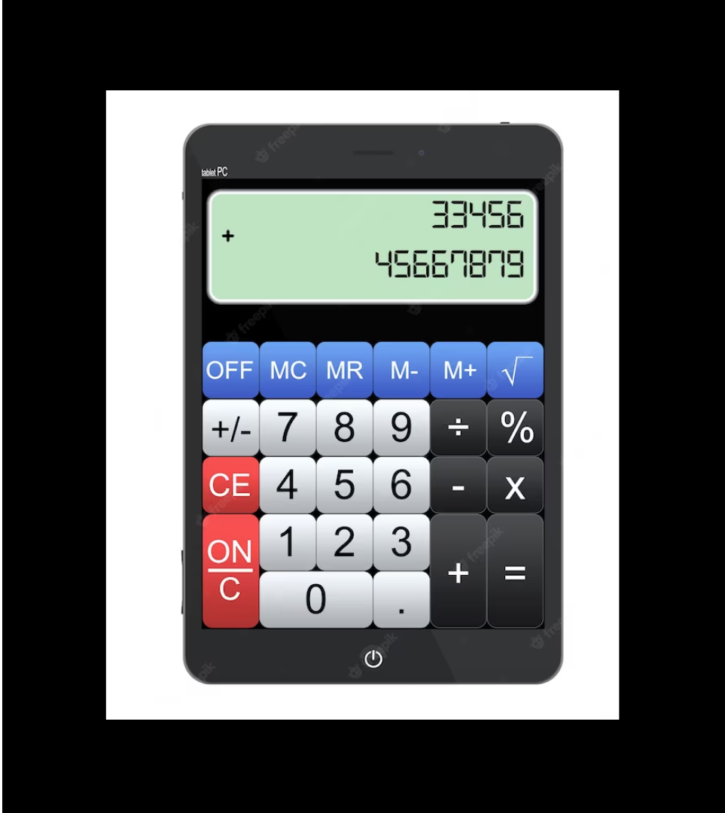
Number Functions
Numeric Functions
MySQL numeric functions are used primarily
for numeric manipulation and/or mathematical
Calculations. POWER,ABS,ISNUMERIC,SIGN
TRUNCATE ,POWER,SQRT,CEIL,FLOOR,ROUND are
some of the most commonly used functions

Slide 26
Number Functions
Name | Description | Example
ABS | Returns the absolute value of numeric expression | select abs(-15) –return 15
POWER | Returns the value of one expression raised to the power of another expression | select power(2,3) –8
SQRT | Returns the non-negative square root of numeric expression. | select sqrt(25)
ROUND | Returns numeric expression rounded to an integer. Can be used to round an expression to a number of decimal points | SELECT ROUND(545895.6877562);--545895 SELECT ROUND(545895.6877562, 3);--545895.688
CEIL | it accepts an integer value as a parameter and returns the smallest integer not less than the given value. | SELECT CEIL(2254.554); --2255 SELECT CEIL(-2254.554); 2254
FLOOR() | Returns the largest integer value that is not greater than passed numeric expression. | SELECT floor(2254.554); --2254 SELECT CEIL(-2254.554); 2255

Slide 27
Number Functions
Name | Description | Example
TRUNCATE() | The TRUNCATE() function of MySQL is used to limit the given number to the desired number of decimal digits | SELECT TRUNCATE(6546841.489484, 0); --6546841 SELECT TRUNCATE(6546841.489484, 3);--6546841.489 SELECT TRUNCATE(-6546841.489484, 3); -6546841.489 SELECT TRUNCATE(-6546841.489484, 0); --6546841
isnumeric | This function returns 1 if the expression is numeric, otherwise it returns 0. | SELECT ISNUMERIC(4567); --1 Select isnumeric(“hello world”) –0
PI | The PI() function returns the value of PI. | SELECT PI();
SQUARE() | The SQUARE() function returns the square of a number. | Select SUARE(4) –16

Slide 28

Date and Time Functions
Date and Time Functions
MySQL date/time functions are used to manipulate temporal values.Sysdate,year,month,day,time,date(),adddate() some of the most commonly used Date functions.These functions can help you to filter and sort the data based on specific date and time ranges

Slide 29
Date and Time Functions
Name | Description | Example
SYSDATE(),current_timestamp(),now | MySQL SYSDATE() returns the current date and time in YYYY-MM-DD HH:MM:SS | Select sysdate() select current_timestamp() select now()
ADDDATE() or date_add | The ADDDATE() function can be used to perform arithmetic operations on dates, such as adding or subtracting days, weeks, months, or years ADDDATE(date, INTERVAL expr unit) Date – Date Interval – Keyword Expr - A date or datetime expression or a number. Unit - An unit | -- what is the date after 7 days SELECT ADDDATE(sysdate(), INTERVAL 7 DAY);-- what is the date of 3 months back SELECT ADDDATE(sysdate(), INTERVAL -3 MONTH); -- Add 2 years current yearSELECT ADDDATE(sysdate(), INTERVAL 2 YEAR);
ADDTIME() | adds expr2 to expr1 and returns the result | SELECT ADDTIME(sysdate(),'1:00:00') –add 1 hr for now

Slide 30
Date and Time Functions
Name | Description | Example
Curdate()/current_date() | Returns today’s date | select curdate(); Select current_date;
Curtime()/current_time() | Returns current time | select curtime()select current_time()
Date() | Extracts the date part of the date or datetime expression expr. Returns NULL if expr is NULL. | SELECT DATE(sysdate()); ---2023-07-17
DATEDIFF(expr1,expr2) | returns expr1 − expr2 expressed as a value in days from one date to the other | SELECT DATEDIFF(sysdate(),'2023-09-17');
DATE_FORMAT(date,format) MONTH | Formats the date value according to the format string. If either argument is NULL, the function returns NULL. | select date_format(sysdate(),'%m'); ---- month numeric select date_format(sysdate(),'%M'); ----- complete month description select date_format(sysdate(),'%b'); -- 3 leters in month
STR_TO_DATE(str,format) | Which converts string to date format | SELECT STR_TO_DATE('01,5,2013','%d,%m,%Y'); SELECT STR_TO_DATE('May 1, 2013','%M %d,%Y');

Slide 31
Date and Time Functions
Name | Description | Example
DATE_FORMAT(date,format) DAY | Formats the date value according to the format string. If either argument is NULL, the function returns NULL. | select date_format(sysdate(),'%d'); ---- day in numbers select date_format(sysdate(),'%W'); ----- complete month descriptionselect date_format(sysdate(),'%a'); -- 3 leters in day
DATE_FORMAT(date,format) YEAR | Formats the date value according to the format string. If either argument is NULL, the function returns NULL. | select date_format(sysdate(),'%Y'); -- year in 4 digitsselect date_format(sysdate(),'%y'); -- year in 2digits
LAST_DAY(date) | akes a date or datetime value and returns the corresponding value for the last day of the month | select last_day(sysdate()) –31
DAYOFWEEK | Returns the weekday index for date (1 = Sunday, 2 = Monday, …, 7 = Saturday). These index values correspond to the ODBC standard. Returns NULL if date is NULL. | SELECT DAYOFWEEK(sysdate()); Sunday = 0
QUARTER(date) | Returns the quarter of the year for date, in the range 1 to 4, or NULL if date is NULL. | SELECT quarter(sysdate())

Slide 32

Aggregate function
Aggregate Function Descriptions
This section describes aggregate functions that operate on sets of values. They are often used with a GROUP BY clause to group values into subsets.

Slide 33
Aggregate function
Name | Description | Example
avg | Return the average value of the argument | select avg(cost) from product
sum | Return the average value of the argument | select sum(cost) from product
max | Return the maximum value | Select max(cost) from product
min | Return the minimum value | Select min(cost) from product
COUNT() | Return a count of the number of rows returned | select count(pc_id) from product ---8 records
COUNT(DISTINCT) | Return the count of a number of different values | select count(distinct pc_id) from product –3 records

Slide 34
Two table visualization to think about queries
SELECT I_NAME, NAME
FROM ITEM INNER JOIN MANUFACTURER
ON ITEM.M_CODE = MANUFACTURER.M_CODE
WHERE
ITEM.I_PRICE BETWEEN 100000 AND 800000;
WRITE A QUERY TO DISPLAY THE MANUFACTURER NAME, ITEM NAME, I_PRICE FOR ALL BAJAJ MANUFACTURER
AND PRICE IS LESS THAN 1,00,000
WRITE A QUERY TO KNOW HOW MANY ITEMS WE HAVE FOR BAJAJ MANUFACTURER.

Slide 35
Two table visualization to think about queries
WRITE A QUERY TO KNOW HOW MANY ITEMS WE HAVE
FOR BAJAJ MANUFACTURER.
COUNT, SUM, MAX, MIN, AVG (Agg functions)
SELECT COUNT(I_NAME) FROM ITEM
WHERE M_CODE = ( SELECT M_CODE
FROM MANUFACTURER
WHERE NAME = ‘BAJAJ’)
SELECT COUNT(I_NAME)
FROM ITEM I INNER JOIN MANUFACTURER M
ON I.M_CODE = M.M_CODE
WHERE M.NAME = ‘BAJAJ’

Slide 36
Two table visualization to think about queries
Find the manufacturer name and number of items
TATA 4
BAJAJ 4
SAMSUNG 0
SELECT NAME, COUNT(I_ID)
FROM MANUFACTURER M LEFT JOIN ITEM I
ON M.M_CODE = I.M_CODE
GROUP BY NAME

Slide 37
Two table visualization to think about queries
Display the manufacturer name and number of items.
Consider only items which are priced more than 1,50,000

Slide 38
JOINS
When we want to display the columns from more than one table in the result set, then you must go for join.
We can make use of simple query or sub query only if we require columns from one table in the result set.
If we want to know the price of the product Dining Table, what type of query you will write?
If we want to know the product which is priced more than Dining Table, what type of query you will write?
Display the product name and product description for all the products which is priced more than 5000 Rs (Business Question)
Analyse the above question. First think about the result you are expecting (do this by seeing the data sets you see from the above tables. How many columns you want to see in the result set. If the result what you are expecting is coming from more than one table, then we have to go for join. We join to get the relevant data from more than one table. The relevant product category of Digital Clock product is Home Electronics.
SELECT p_name, pc_desc FROM product_category INNER JOIN product ON product_category.pc_id = product.pc_id Where p_price > 5000

Slide 39
JOINS
When we need to see or process data based on multiple tables (more than one), we go for joins. When we join, the related records between two tables gets displayed.
Inner Join, Outer joins are the most widely used concepts in the joins.
Consider city table and customer table. Assume we are serving 10000 customers from 15 different cities.
Display city_name, customername, customer age who are from the city of Bangalore or Chennai.
Display customer name, city name, city population , customer gender for those customer who is data of birth falls in the current month.

Slide 40
Join Types
Join (Get the data from more than one table in the result set)
INNER (matching records only)
OUTER (matching plus un matching records)
LEFT (matching records between two tables and unmatching from left side of the table in the FROM clause)
RIGHT (matching records between two tables and un matching records from right side of the table in the FROM clause)
FULL (matching records from two tables, un matching records from LEFT Table and un matching records from RIGHT side of the table in the FROM clause.
SELF
Joining the same table in the FROM clause is called as Self Join. This typically happens when you see a table which has the self referential integrity constraints.
CROSS
Result of this type of join is the product of two tables. If city table has 50 records and customer table has 500 records, cross join will result in (a * b) = (50 * 500) rows.
Usage of Cross JOIN in RDBMS world is very rare.

Slide 41
Aggregated Queries
Sum, max, min, avg and count are the aggregate functions in the SQL.
Aggregation happens on group of rows.
Say if we have 100 records in customer table, 40 of them are from Bangalore, 20 of them are from Chennai, 30 of them are from Mumbai and 30 of them are from delhi.
Select count(*) from customer – counting happens on the entire table.
Select city, count(cust_id) from customer group by city – counting happens on the group of records (4 groups – Chennai, Bangalore, Mumbai and delhi)
Display the city and customer count who are male customers and who were born in the year of 2000.
Display city name which has more than 35 customers

Slide 42
Group by Query
select state_name, count(city_name), sum(city_population), max(city_population), min (city_population) from state LEFT join city on state.state_id = city.state_id GROUP BY state_name
Find the country_name, state_name, count of cities
Find the product_family, product_category_Desc and number of products
SELECT country_name, state_name, count(city_name) FROM country inner join state on country.country_id = state.country_id inner join join city on state.state_id = city.state_id GROUP country_name, state_name
In the above query, you have one column where you are using aggregate function (on city_name), other than that column, we have two non aggregate columns. In this type of scenarios, we should include all the non aggregated columns in the GROUP BY clause.

Slide 43
Group by & Having Clause
Find the state_name, count of cities, consider states which are having more than 2 cities in that state.
SELECT state_name, count(city_name) FROM state inner join city on state.state_id = city.state_id GROUP by state_name HAVING count(city_name)> 2
Having clause is considered as the filter clause on your grouped by result set.
Most of us try to solve this query in the following way.
SELECT state_name, count(city_name) FROM state inner join city on state.state_id = city.state_id WHERE count(city_name) > 2 GROUP by state_name
Above query wont work, where clause works on the table / view data to filter the data. You will get a syntax error (aggregate functions cannot be used in where clause). The reason is the aggregate functions happens after we apply the where clause.
Tip: Don’t use Having clause with out using GROUP by clause.

Slide 44
Co-related Sub Query
In few scenarios we have to use correlated sub queries. In the following example, you have to show the expensive (price) product in each category.
You feel like, you can solve this with sub query, but scenarios in the data sets will give wrong results. So, we have to implement correlated sub queries when sub queries does not give the results we expect.
Select prod_cat, prod_name,price from product p1 where price = (select max(price) from product p2 where p2.prod_cat = p1.prod_cat)
Watch the query, in this case inner query wont execute until outer query supplies the value. Both the queries are dependent on each other to complete their respective tasks. This is the reason its called as correlated sub queries.
Outer query executes first, for every record in the outer query, inner query executes and provide the related value which decides the result set.
You should also analyze the following query where we are identifying cities where we don’t have customers
Select city_name from city where not exists (select city_id from customer where customer.city_id = city.city_id)
The above query can be solved it by using sub query as well. So, my recommendation is, when you are not getting the desired result by using sub query, look towards co-related subquery to get the desired result.

Slide 45
Set Operators
When we are dealing two different result sets, we tend to use set operators.
Consider an example of lead table and customer table. Lead table is created to get the leads from various partners, so that call center folks can call them to offer products we have. For example in india Airtel, Jio, icici bank gets lead from different partners to sell their services.
These organizations already have a customer table with in the organization. Some times, the leads what we got are already customers of these organizations. In this stage, we have two data sets which has similar data.
Process can ask us to identify the common records between the lead and customer table, so that we can use these records for upsell. Idenfity the leads which are not in customer table so that we can offer new upcoming promotions so that they can become customers.
Lead (lead_f_name, lead_l_name, phone, email, city) customer (cust_id, cust_f_name, c_l_name, phone, email, city, cust_dob…)
In the above case we have to identify the common records.
Set operators are union, union all, intersect and minus. In mysql union and union all are supported.

Slide 46
Derived Table / Inline View
While solving few scenarios, we typically tend to see the intermediate results and consider them as a table.
How we have derived column (calculation of profit), considering a result set of a query as a table is called Derived table.
Select city, NoOfCustomers from (Select city, count(cust_id) as NoOfCustomers from city inner join customer on city.city_id = customer.city_id group by city) city_customer_count where NoOfCustomers > 50
Analyze the above query and see what is the result and the approach we took.
Here we call city_customer_count as the derived table.
Considering the result as a table in the Select is called as derived table.

Slide 47
Dealing with Null values
NULL cannot be compared with any SQL operator like = , <>, IN, NOT IN etc
You can include IS NULL or IS NOT NULL while you are checking the value.
select distinct dept_name, if (emp_name is null, 'no employee','employee') status from department left join emp on department.dept_id = emp.dept_id
In the following example, if emp_name is null then it displays no employee.
Select dept_name, ifnull(emp_name,'no employee') from department left join emp on department.dept_id = emp.dept_id

Slide 48
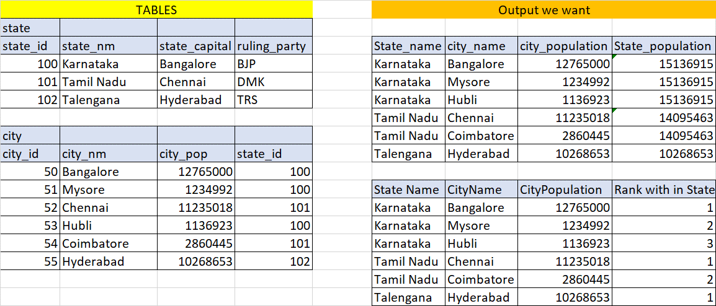
Analytical Queries
Please do analyze the output required and think about what has to happen to get the desired result.
Tip: Summation of city population happens within each state
Tip: Ranking of city based on the population with in the state.

Slide 49
Ranking function usage & example of derived table
SELECT city_name, population, RANK() OVER (ORDER BY population desc ) pop_rank dense_rank() over (order by population desc) drank FROM city;
SELECT state_name, city_name, population, RANK() OVER (ORDER BY population desc ) pop_rank FROM city inner join state on city.state_id = state.state_id
select state_name, city_name, population, pop_rank from (SELECT state_name, city_name, population, RANK() OVER (ORDER BY population desc ) pop_rank FROM city inner join state on city.state_id = state.state_id ) city_rank where pop_rank <= 5

Slide 50
Using Partitions and Over by clause
select state_name, city_name, population, sum(population) over (partition by state_name) state_population from city inner join state on city.state_id = state.state_id
select state_name, city_name, population, sum(population) over (partition by state_name) state_population, sum(population) over () as total_population, rank() over (order by population_desc) overall_pop_rank, rank() over (partition by state_name order by population desc) city_rank from city inner join state on city.state_id = state.state_id

Slide 51
Derived Table
Deriving a column in our result set which does not exists in the table is called Derived column. In product table, you have cost and price as columns, we want profit as a column in the result, here we derive a column called profit based on price – cost formula.
Considering a table based on the result set of a query is called as derived table. In the below query, temp is the derived table. The result set of the inner query is considered as table and write a query on top of that derived table is the typical usage of derived table.
select sal from (SELECT sal, RANK() OVER (ORDER BY sal desc ) sal_rank FROM employee ) temp where sal_rank <= 3
select sal from (SELECT sal, DENSE_RANK() OVER (ORDER BY sal desc ) sal_rank FROM employee ) temp where sal_rank <= 3

Slide 52
Case Statement
select case when date_format(sysdate(),'%W') in( ‘Saturday‘, ‘Sunday’) then ‘Weekend' else ‘Working Day' end as WorkDay
Select customer_name, customer_city, case when upper(gender) = ‘M’ then ‘Male’ case when upper(gender) = ‘F’ then ‘Female’ end as Gender from customer

Slide 53
View
Customer
---------------------------
Cust_id
Cust_name
Cust_dob
Cust_gender
Cust_city
Cust_state
Cust_country
Cust_phone
Cust_email
Customer table consists of customers from India, SL and Bangladesh
Business Users from India, SL and Bangladesh.
RAM – INDIA
UMA – INDIA
KUMAR – SL
MARIAN – SL
BABU – Bangladesh
SURAJ – Bangladesh
India users should get access to india customers, SL users should get access only to Srilanka customers, Bangladesh users should get the same access.
View – virtual table (does not take physical space)
Create view ind_customers as select * from customers where cust_country = ‘INDIA’
GRANT ALL ON ind_customers to RAM, UMA
Select * From ind_customers;
Secure the data based on business rules
Insert into ind_customers values (…….)
1250 customers
750 customers from india
200 customers from SL
300 customers from Bangladesh

